Slide 1

Huazhong University of Science and Technology
The Department of Electronics and Information Engineering
Electronic Circuit Analysis and Design
Dr. Tianping Deng
Email: dengtp@hust.edu.cn

Slide 2
Contents
PART 1 SEMICONDUCTOR DEVICES AND BASIC APPLICATIONS
Chapter 1 Semiconductor Materials and Diodes
Chapter 2 Diode Circuits
Chapter 3 The Field-Effect Transistor
Chapter 4 Basic FET Amplifiers
Chapter 5 The Bipolar Junction Transistor
Chapter 6 Basic BJT Amplifiers
Chapter 7 Frequency Response
Chapter 8 Output Stages and Power Amplifiers
PART 2 ANALOG ELECTRONICS
Chapter 9 Ideal Operational Amplifiers and Op-Amp Circuits
Chapter 10 Integrated Circuit Biasing and Active Loads
Chapter 11 Differential and Multistage Amplifiers
Chapter 12 Feedback and Stability
Chapter 13 Operational Amplifier Circuits
Chapter 14 Nonideal Effects in Operational Amplifier Circuits
Chapter 15 Applications and Design of Integrated Circuits
Chapter 2 Diode Circuits

Slide 3
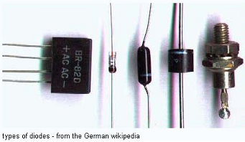
Ch2. Diode Circuits
2.1 Rectifier Circuits
2.2 Zener Diode Circuits
2.3 Clipper and Clamper Circuits
2.4 Multiple-Diode Circuits
2.5 Photodiode and LED Circuits
2.6 Design Application: DC Power Supply
2.7 Summary

Slide 4

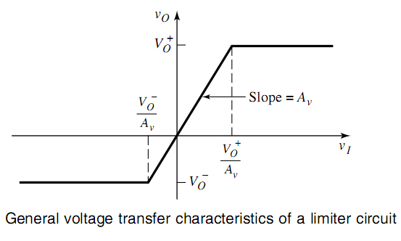
2.3 Clipper and Clamper Circuits

Slide 5

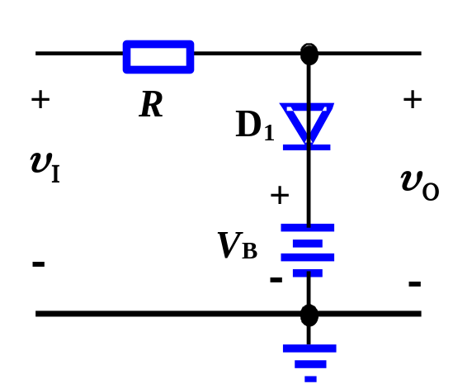

2.3 Clipper and Clamper Circuits
2.3.1 Clippers (Limiter Circuits)
Clippers are used to eliminate portions of a signal that are above or below a specified level
(1) Single-diode clipper
v_{I} < V_{B} +V_{r} , D₁ “off”, v_{R}= 0 , v_{O}= v_{I} .
v_{I} >V_{B} +V_{r} , D₁ “on”, v_{O} is clipped , v_{O}= V_{B} +V_{r} .
υ
O
υ
I
V
B
+
V
γ
π
2π
t
0
υ
O

Slide 6
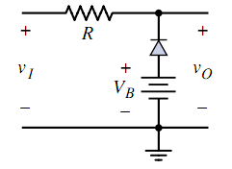
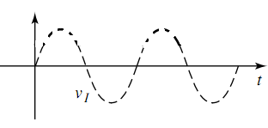
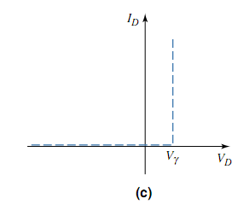
2.3 Clipper and Clamper Circuits
off
on

Slide 7
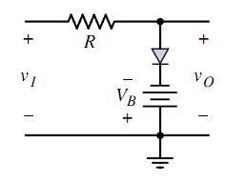



2.3 Clipper and Clamper Circuits
on
off

Slide 8
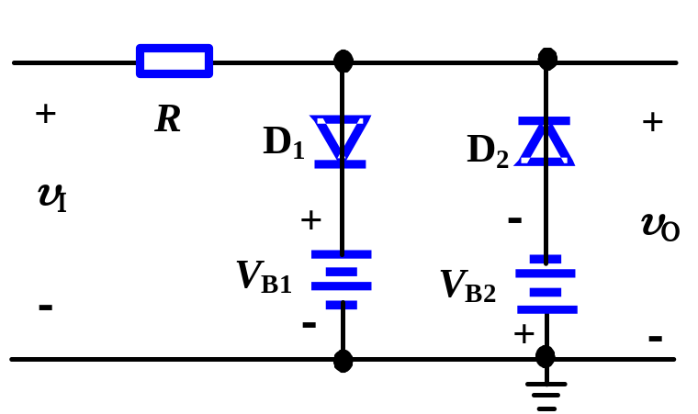
2.3.1 Clippers (Limiter Circuits)
(2) Double limiter (Parallel-based clipper)
–(V_{B2} +V_{r} ) <v_{I} < V_{B1} +V_{r} , D₁,D₂ “off”, v_{R}= 0 , v_{O}= v_{I} .
v_{I} <–(V_{B2} +V_{r} ) , D₂ “on”, v_{O} is clipped , v_{O}= –(V_{B2} +V_{r} ) .
v_{I} > V_{B1} +V_{r} , D₁ “on” , v_{O}= V_{B1} +V_{r} .
υ
O
υ
I
V
B
+
V
γ
π
2π
0
t
−
(
V
B
+
V
γ
)
υ
O

Slide 9
Questions
and
Answers

